Slide 1
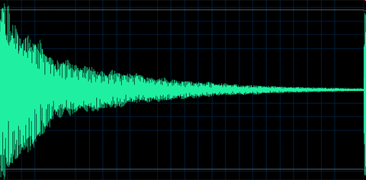
MOTIVATION

Slide 2
MOTIVATION
The psychological feature that arouses an organism to action toward a desired goal; the reason for the action; that which gives purpose and direction to behavior.
Motivation is the set of reasons that determines one to engage in a particular behavior.
Notes:
Drive theory. Drive is a psychological state that occurs because of physiological need.

Slide 3
TYPES OF MOTIVES
BIOLOGICAL MOTIVES
Oxygen
Hunger
Thirst
Sex
Avoidance of Pain
Temperature regulation
Bladder tension
Fatigue

Slide 4
Primary/Biological Needs
Biological motives are called as physiological motives.
These motives are essential for the survival of the organism. Such motives are triggered when there is imbalance in the body.
The body always tends to maintain a state of equilibrium called “Homeostasis”- in many of its internal physiological processes.
This balance is very essential for the normal life.
Homeostasis helps to maintain internal physiological processes at optimal levels.
The nutritional level, fluid level, temperature level, etc., are maintained at certain optimal level or homeostasis levels.
When there is some variation in these levels the individual is motivated for restoring the state of equilibrium.
For example, hunger, thrust, temperature, sleep etc.

Slide 5
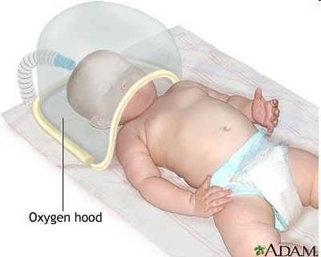
Oxygen:
oxygen is the most basic need of every living being without it no one can survive.

Slide 6
Homeostasis: biological “thermostats”
  homeostasis is a process by which internal body mechanisms sense biological imbalances and stimulate action to restore the proper balances
  Or The body tendency to maintain an equilibrium or balance
  homeostatic controls exist for hunger, thirst, body temperature, electrolyte levels, etc.
  we will discuss hunger and thirst motives in detail next.

Slide 7
2. Hunger:
Role of stomach cues
Role of the brain
Eating Disorders
1. Obesity
2. Anorexia Nervosa
3. Bulimia

Slide 8
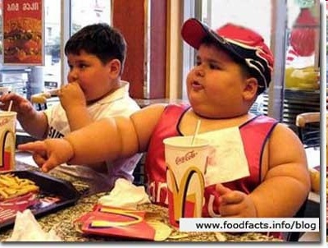
Brain,Hypothalamus,
Ventromedial,obese
Lateral ,starvation
Obese: Their body
weight more than 20% of
average weight compared
to height.
Hypersensitive to
external cues
a. Higher set-point
b. Lower metabolism
c.Hypothyroidism

Slide 9
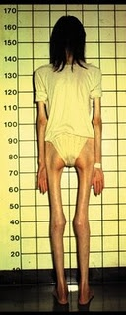
Anorexia nervosa
Self-starvation and dramatic weight loss - 25% of normal body weight
70% recover and maintain normal body weight
Usually they are young females
Causes:
Ventromedial hypothalamus; obese
Lateral hypothalamus; starve

Slide 10
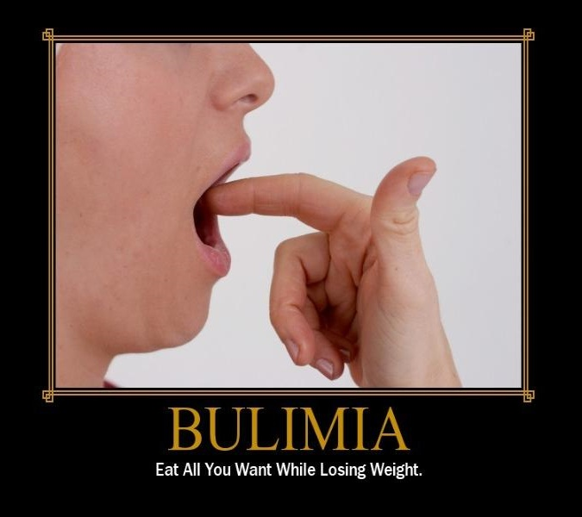
Bulimia
Eating quantities of food and then eliminating it by self-induced vomiting or strong laxatives
99% are female, a majority are college students
Do maintain a "normal" body weight - are in "control" .

Slide 11
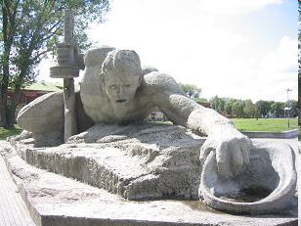
3. Thirst:
Thirst is the regulation of fluid intake
Biological regulation of thirst
  a “drink” and a “stop drinking” center are located in different sections of the hypothalamus
  homeostatic
  DEHYDRATION
  Blood loss also cause thirst.

Slide 12
4. Sex Motive:
The biological need for sex is an unusual physical motive in such an individual can survive an entire lifetime without once satisfying it,but this need is Important for survival of the human race.
Role of hormones

Slide 13
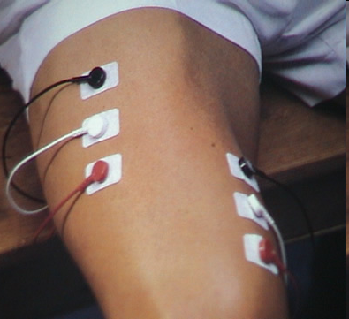
5. Avoidance from pain:
Every one wants to get rid of pain.

Slide 14
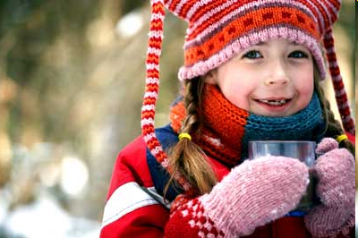
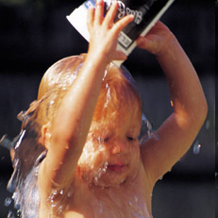
6. Temperature regulation:
This is obtained through the use of clothing, location, and the building of protecting structures. 98.6 degrees or 37degree celsius

Slide 15
7. Bowel and Bladder tension:
All organisms create waste products via the processes of living. Much waste comes from food. The rest is produced by movement, growth, and other functions of living. If this waste remained in living things, it would soon cause illness and death. Thus living things must have a way to dispose of waste matter.

Slide 16
Fatigue.
Tiredness ,lethargy in muscles.
Types of fatigue
SLEEP.
Hypothalamus,insomnia, Time span,psychological and physical effects

Slide 17
Secondary/Social Motives
Physiological motives discussed above pertain to both animals as well as human beings, but the social motives are specific only to human beings.
These are called social motives, because they are learnt in social groups as a result of interaction with the family and society.
That is why their strength differs from one individual to another.
Many social motives are recognized by psychologists. Some of the common social motives are:
  Achievement
  Affiliation
  Power

Slide 18
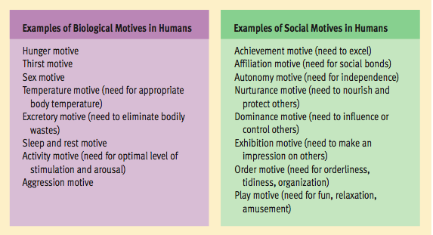

Slide 19
Social motives
Need for achievement:
Refers to an individual's desire for significant accomplishment, mastering of skills, control, or high standards.
The need for success in competitive situations
  fear of failure
    failure to try because of fear you might not succeed
  fear of success
    snatching defeat out of the mouth of victory because of fear of success

Slide 20
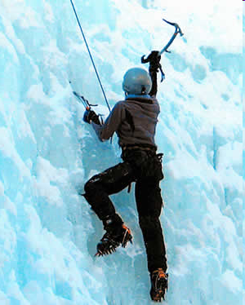

Slide 21
Need for affiliation:
The Need for Affiliation (N-Affil) is a term that was popularized by David McClelland and describes a person's need to feel a sense of involvement and 'belonging' within a social group. Every one wants to have friends. concept of attachment

Slide 22
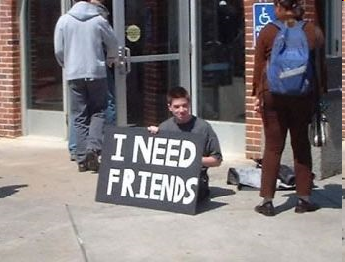

Slide 23
Need for Achievement
Highest in Maslow hierarchy
People high on Achievement are characterized by a tendency to seek challenges and a high degree of independence. Their most satisfying reward is the recognition of their achievements Need for Achievement is related to the difficulty of tasks people choose to undertake..

Slide 24
Need for power:
People who exhibit power tendencies are thought to be most satisfied by seeing their environment move in a certain direction, due to their involvements. As an example of the need for personal power, most corporate leaders seek high level positions so as to control the direction in which their company is moving.

Slide 25
Intrinsic and Extrinsic Motivation
Intrinsic motivation is stimulated by the inherent nature of the activity itself; by the process itself and with no external rewards
Extrinsic motivation is stimulated not by the process itself but by what can be gotten from doing the activity, e.g., a reward or recognition or other gain

Slide 26
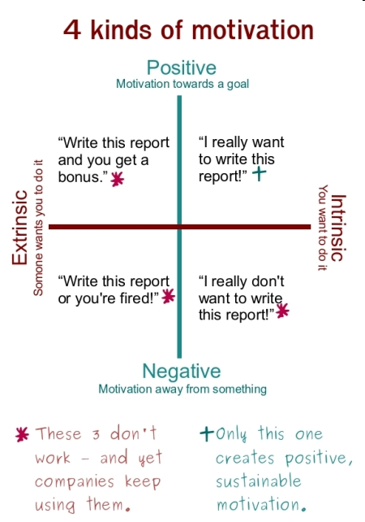

Slide 27
Theories
Drive theory. Drive is a psychological state that occurs because of Physiological need. Drive reduction theory states that physiological need creates an aroused state that motivates to satisfy need. Homeostasis

Slide 28
Abraham Maslow’s Hierarchy Theory:
Maslow saw human needs in the form of a hierarchy, ascending from the lowest to the highest, and he concluded that when one set of needs is satisfied, this kind of need ceases to be a motivator.

Slide 29
Maslow’s Hierarchy:
Ordering Motivational Needs
He believed a person must satisfy the needs at the lower levels before moving on to tackle the ones at the top.
For example, if you don’t have enough to eat, or scared you may lose your house, you probably won’t strive as much for personal accomplishment.
Abraham Maslow believed that people strive for a positive view of the self to realize their own potentials fully.
Believed these needs were innate but without a supportive, nurturing environment, this essential striving for full potential could not take place.
In other words, he believed we all strive to work at our fullest potential. We all want to become “self actualized” that is reaching and using our full potential in our vocational and personal life.
Maslow’s hierarchy of needs has also spawned other approaches to motivation.

Slide 30
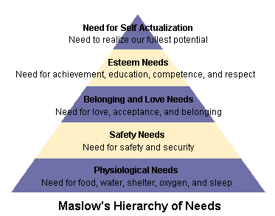

Slide 31
Theories
Motivational need theory
David Mcclelland
Need to Achieve(n.ach), Need to Power(n.pow), Need for Affiliation(n.affil)
Need to Achieve(n.ach)
High on this need likes to work alone,they take moderately difficult goals and calculated risks enjoy challenging tasks.

Slide 32
Need to Power(n.pow)
It is related to success in exercise of managerial leadership and is associated with prestige, social eminence,superiorty which can affect an individual concept.
Wants to control and influence others.
Likes to win arguments.
Enjoys competition and winning.
Enjoys status and recognition

Slide 33
Need for Affiliation(n.affil)
Team players.need to be friendly and popular .
Wants to belong to the group.
Wants to be liked, and will often go along with whatever the rest of the group wants to do.
Favors collaboration over competition.
Doesn't like high risk or uncertainty.
All three needs affect their behavior and working managing styles and relationships with workers and employers.

Slide 34
Equity theory or Motivation in Management.
J.Stacy Adams
Equity means motivation to secure what people perceive to be fair return for their efforts e.g
Input—Output

Slide 35
Input: what we give or put into work
Output: Outcome, everything we take out in return
Two types of inequity result from input/output ratio
    Negative inequity.
    Positive inequity.

Slide 36
When individuals perceive inequity, the can:
  Change their inputs.
  Change their outcomes.
  Distort perceptions of self.
  Distort perception of others.
  Leave the field

Slide 37
Expectancy and Management control.
Victor Vroom
Expectancy means anticipation of possible outcome of various actions a person takes.
Model:Valence,(strength of performance for a particular outcome) first level outcome immediate effect after work Welldone,secondlevel results from level one e.g promotion.

Slide 38
Expectancy: Belief ones effort will result in attainment of desired performance.
Instrumentality: the connection between performance and rewards.

Slide 39
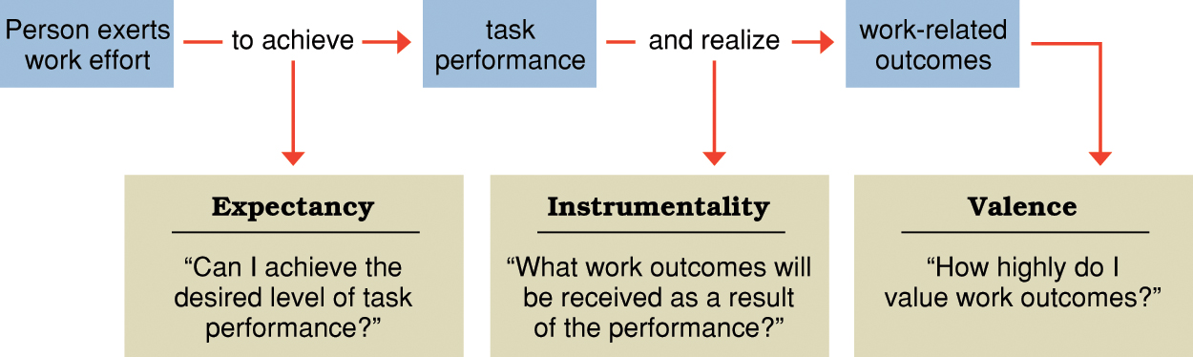
Elements in the expectancy theory of motivation

Slide 40
  Motivation (M), expectancy (E), instrumentality (I), and valence (V) are related to one another in a multiplicative fashion:
        M = E x I x V
  If either E, I, or V is low, motivation will be low.

Slide 41
Need for Achievement (David McClelland)
  A stable, learned characteristic in which a person obtains satisfaction by striving for and achieving challenging goals.
Expectancy theory (Victor Vroom)
  Assumes that behavior results from conscious choices among alternatives whose purpose it is to maximize pleasure and to minimize pain.
Equity theory (J Stacy Adams)
  Individuals are motivated by fairness, and if they identify inequities in the input or output ratios of themselves and their referent group, they will seek to adjust their input to reach their perceived equity

